Slide 1
First Wind Northeast Transmission Overview
Restructuring Round Table December 9, 2011

Slide 2
First Wind Strategy: Construct Our Own Path to Market
Generator lead lines built to accommodate project
and if possible, future development.
New England: Line 56 – Evergreen Gen Lead
  38 Mile 115kV Line with 215 MW Capacity, Operational Q1 2009
  Stetson I & II, 57MW & 25.5MW, COD Q1 2009 & Q1 2010
  Rollins, 60MW, COD Q3 2011
  Bowers, 62MW, Under Development
West: Milford, Utah – Milford Wind Corridor
  98 Mile 345kV Line with 1000 MW Capacity, Operational Q4 2009
  Milford Projects, 300 MW Operational, 700 MW Under Development
Notes:
Summary of Talk from Email:
September focused on FERC Order 1000
December focusing on major new transmission and renewable related studies and potential projects.
For the studies
EIPC lined up
hoping to add MIT's Grid study
and NESCOE's renewable and transmission assessments (both MIT and NESCOE due out in November).
For the potential projects
NU Transmission President Munz to talk about the NU/NSTAR/HQ line
Atlantic Wind Connection CEO Bob Mitchel confirmed to talk about the off-shore "google" line.
Would like to add you to this 2nd panel to provide a New England based wind developers perspective on transmission, as well as talk a bit about any specific proposed renewable-related transmission projects in Maine.
May also add HQ rep. to talk about both their renewable development and transmission plans.

Slide 3
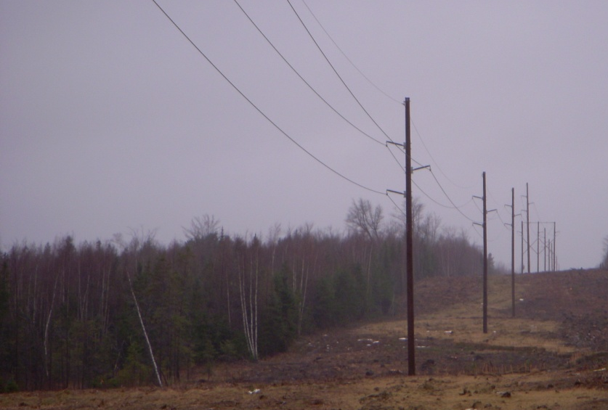
Transmission to Unlock Value
Stetson 215 MW Generator Lead
First Wind project
First Wind’s Generator Lead
Major transmission lines
Substations

Slide 4
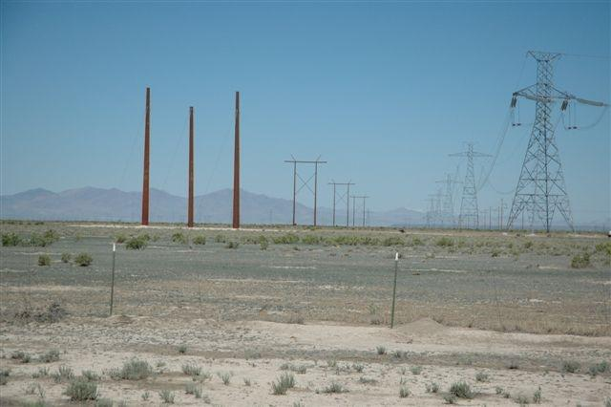
Transmission to Unlock Value
Milford, Utah
1,000 MW
Generator Lead
First Wind project
First Wind’s Generator Lead
Major transmission lines Substations

Slide 5
New Opportunities Under Development
Future Generator Lead Opportunities in New England
  Oakfield Generator Lead
  60 Mile 115kV Gen Lead
Major Transmission Projects and Partnerships
  Northeast Energy Link
  230 Mile HVDC Link from Orrington Maine to Tewksbury Mass

Slide 6
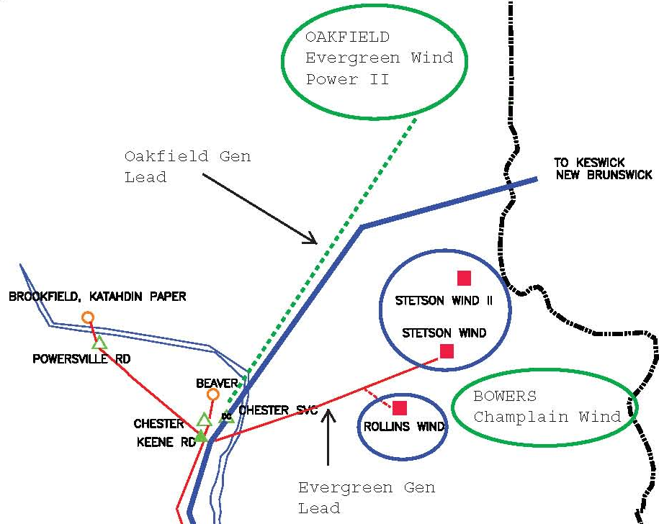
Oakfield Project & Generator Lead
Oakfield:
150 MW
60 Mile 115kV Line
Corridor and Gen Lead unlock generation potential in the area.
Notes:
This is the near future, difficult to make the incremental project-by-project steps under our current interconnection process and generator pays cost allocation process. We work with what we’ve got.

Slide 7
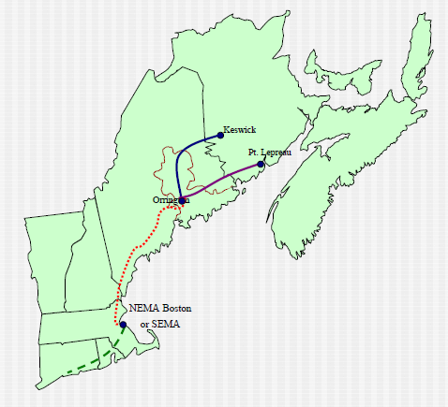
Northeast Energy Link – National Grid and Bangor Hydro Elec.
Northeast Energy Link connects Northern Maine to Massachusetts
$2.2 Billion Investment
240 Miles of DC line
1000 MW of Capacity
Notes:
FW has been working with NEL Partners, National Grid and Bangor Hydro Electric on a Transmission Services Agreement.
Benefits, unlocking needed generation. Challenges, security needs of utility for investment.
FERC recognized that in Order 1000, does not replace projects like NEL, may help to be a tool in getting them in the ground.

Slide 8


Slide 9


This presentation was given at the 12.9.2011
New England Electricity Restructuring Roundtable,
“Renewable Energy-Related Transmission for New Englanders: by Land and by Sea” convened and moderated by Raab Associates, Ltd.

